Slide 1
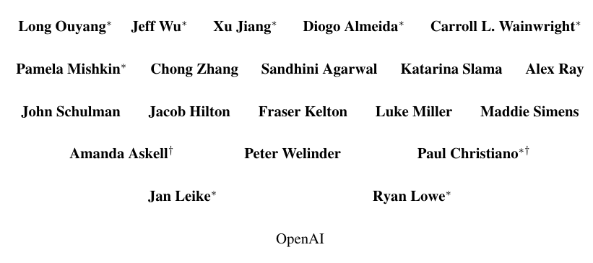
InstructGPT/ GPT 3.5
Training language models to follow instructions with human feedback
# of citations as of today - 13331
2022 March
Notes:
20 authors
before chatgpt, has inspired it RHLF(reinforcement learning with human feeback)
This is in part because GPT‑3 is trained to predict the next word on a large dataset of Internet text

Slide 2
Overview
Large language models (LMs) can perform a range of natural language processing (NLP) tasks when prompted with examples.
However, these models often exhibit unintended behaviors, such as generating biased or toxic text, making up facts, or not following user instructions.
They aim to align LMs by training them to act in accordance with the user's intention, including explicit and implicit intentions. But evaluating the model to be helpful, honest, and harmless.
Fine-tuning approaches to align language models to follow a broad class of written instructions with reinforcement learning from human feedback (RLHF).

Slide 3
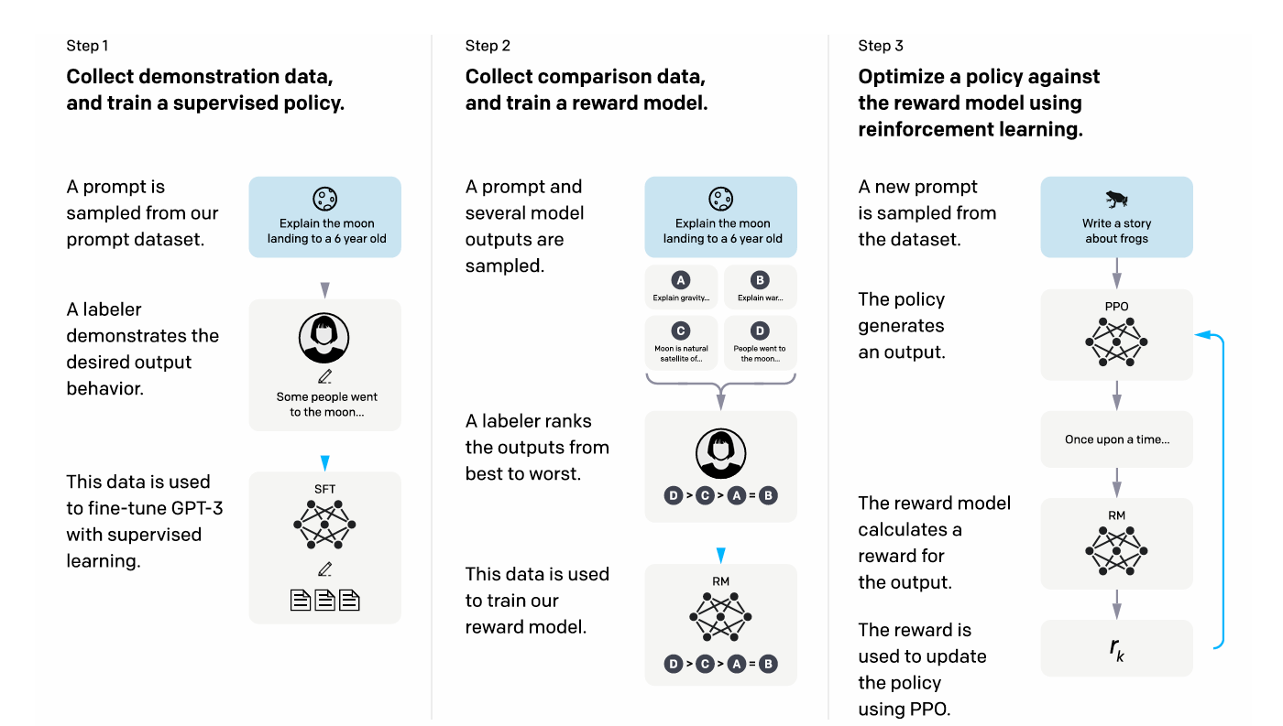

Slide 4
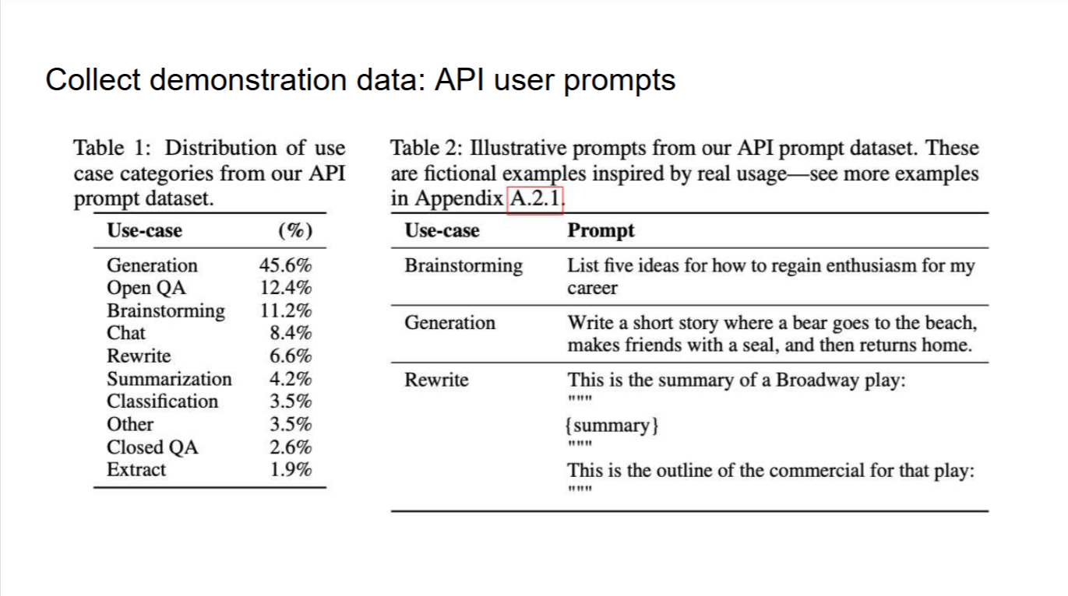

Slide 5
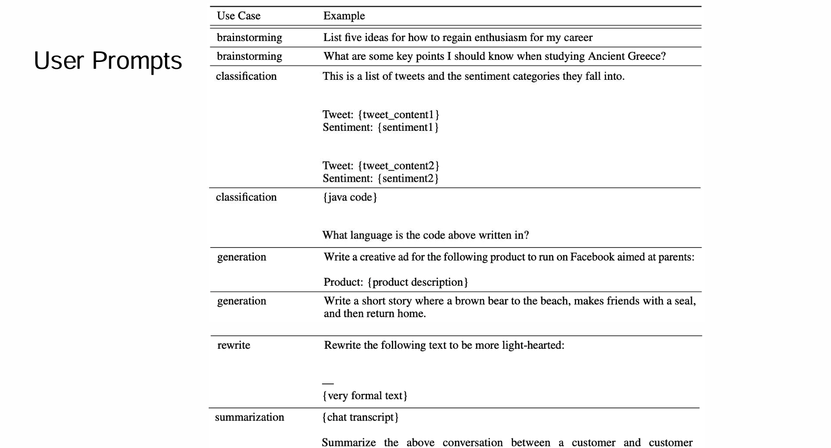

Slide 6
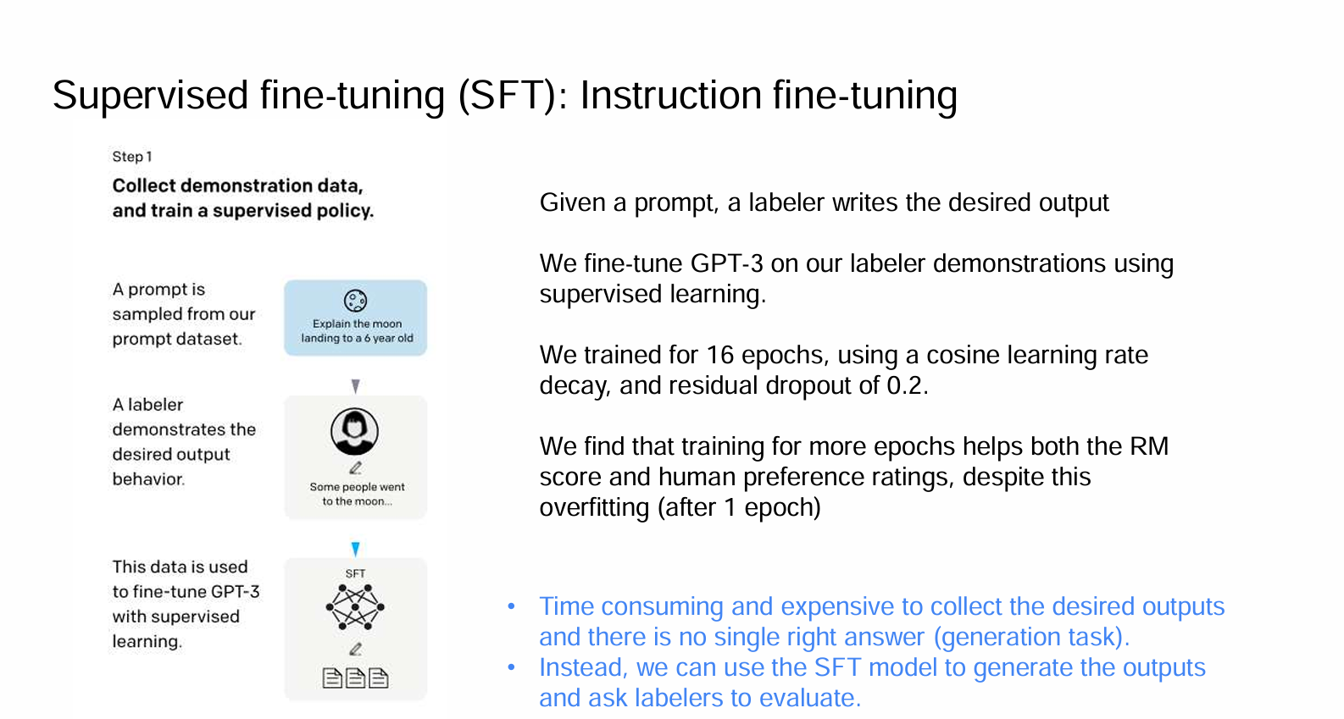

Slide 8
Step 2 - Train the reward model(RM)
Input prompt + answer –-> reward (a scalar value)
Transformer based model (6B parameters)
Notes:
used as the value function during RL

Slide 9
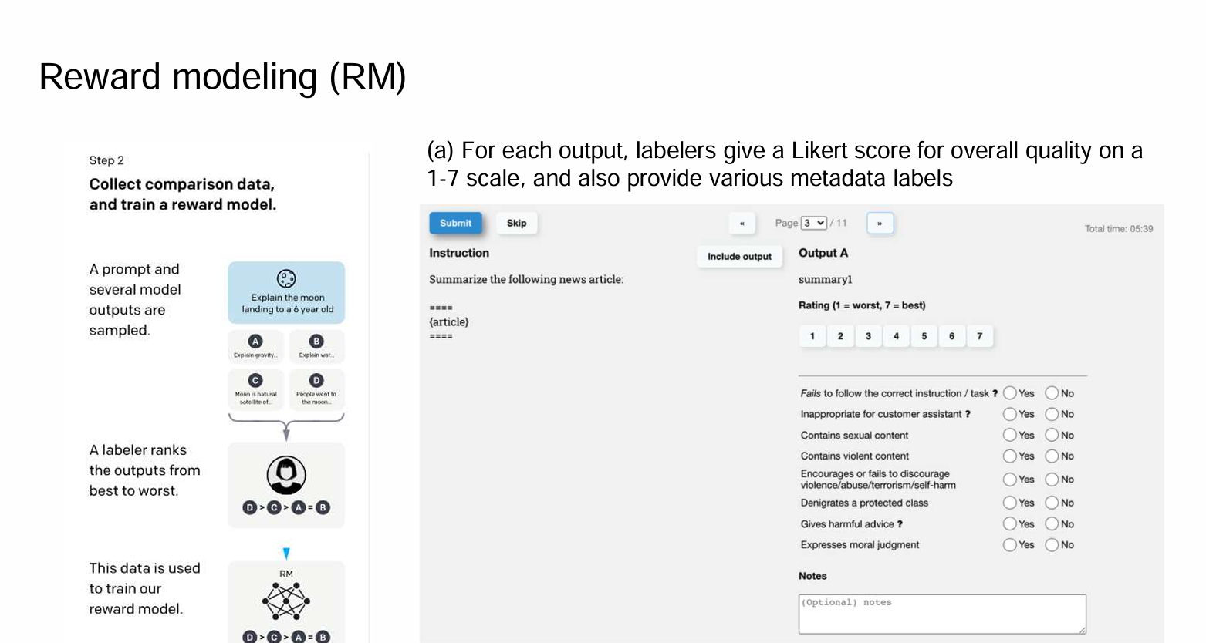

Slide 10
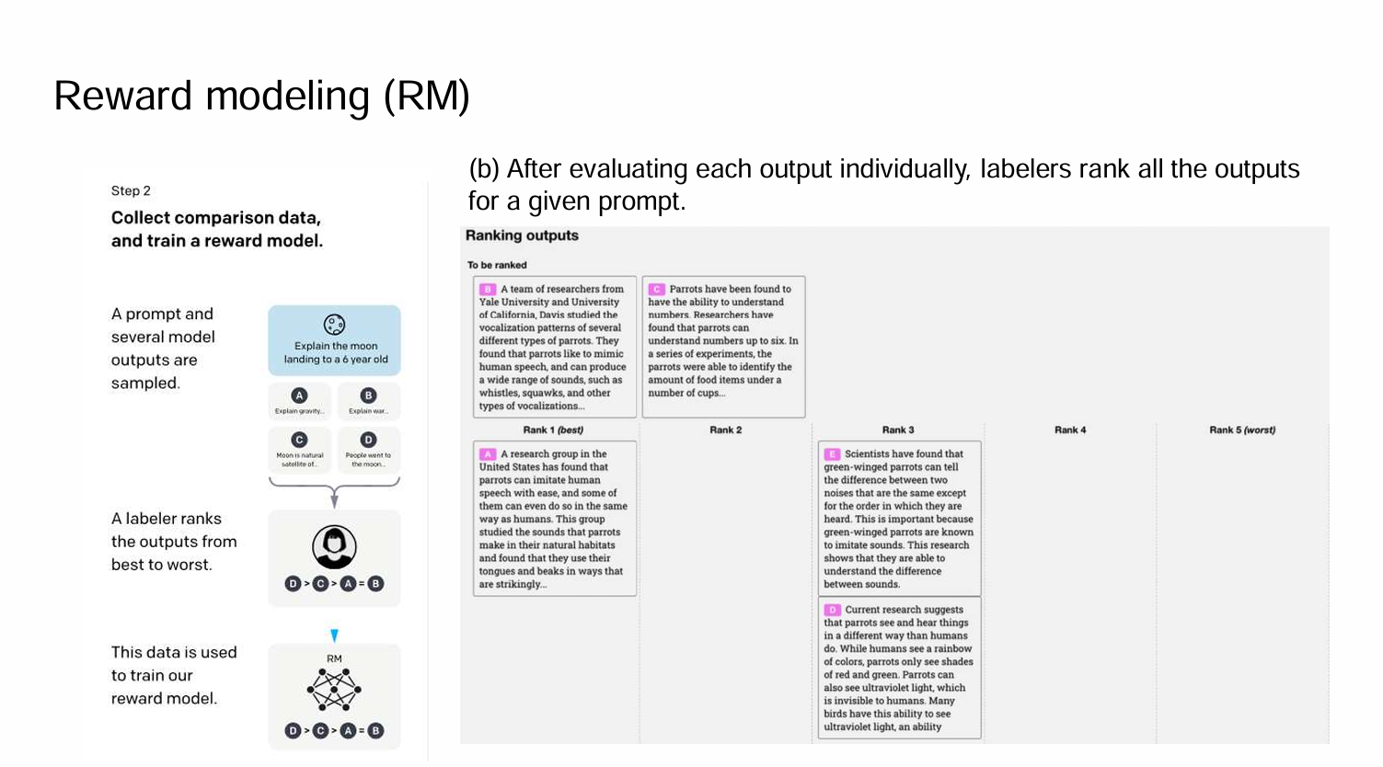

Slide 11
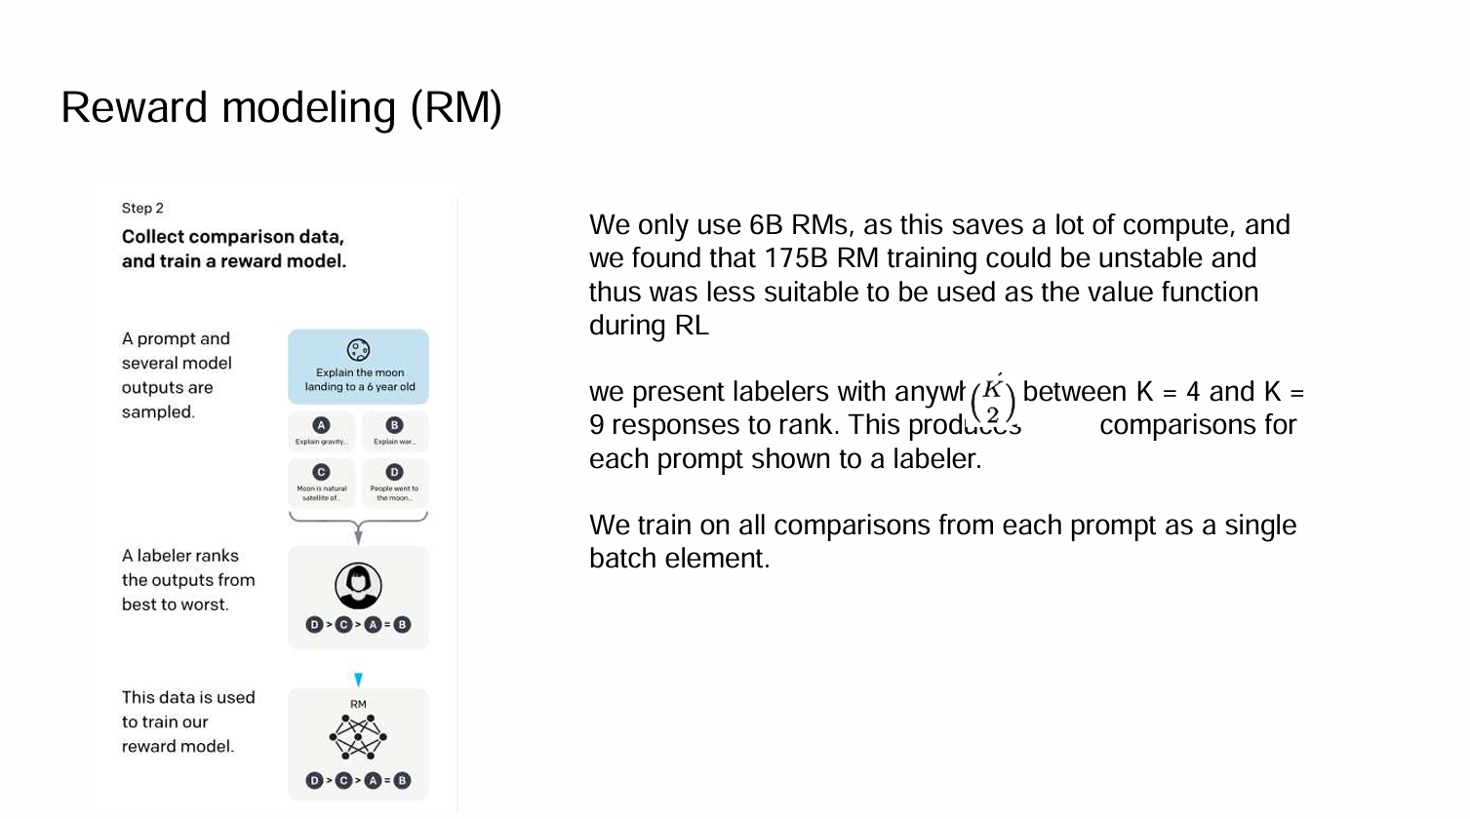

Slide 12
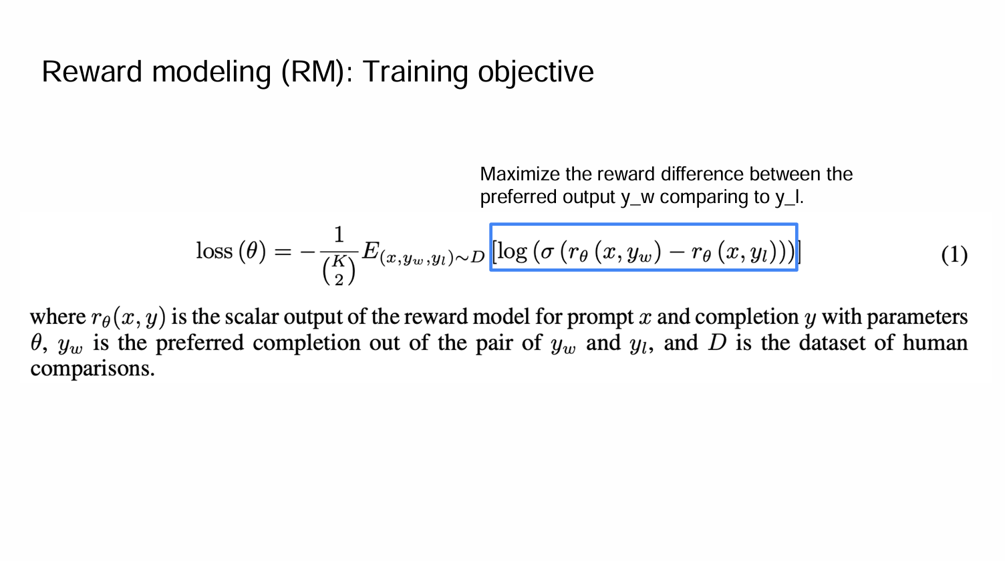

Slide 14
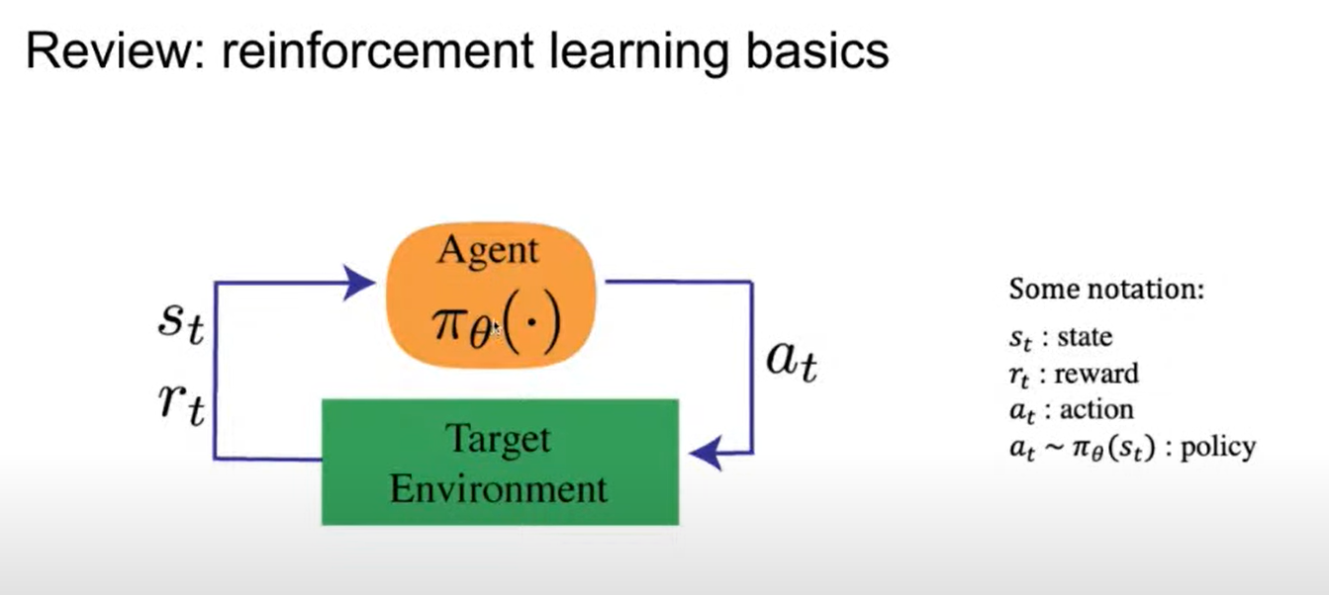
Step 3 - Reinforcement learning
In our case state = prompt , action = answer

Slide 15
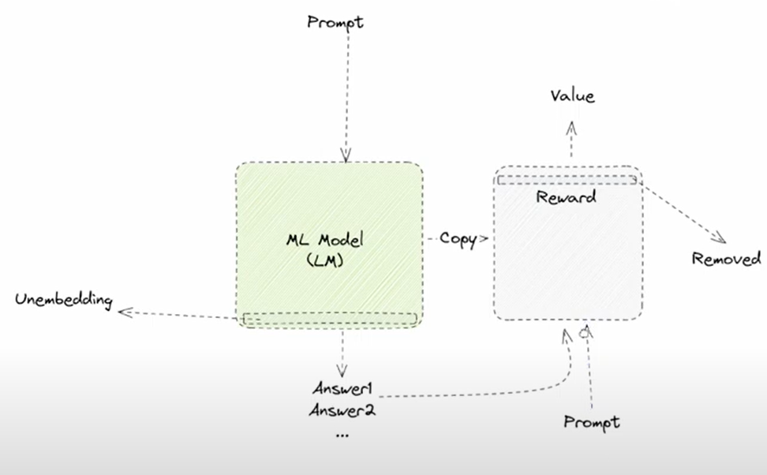

Slide 16
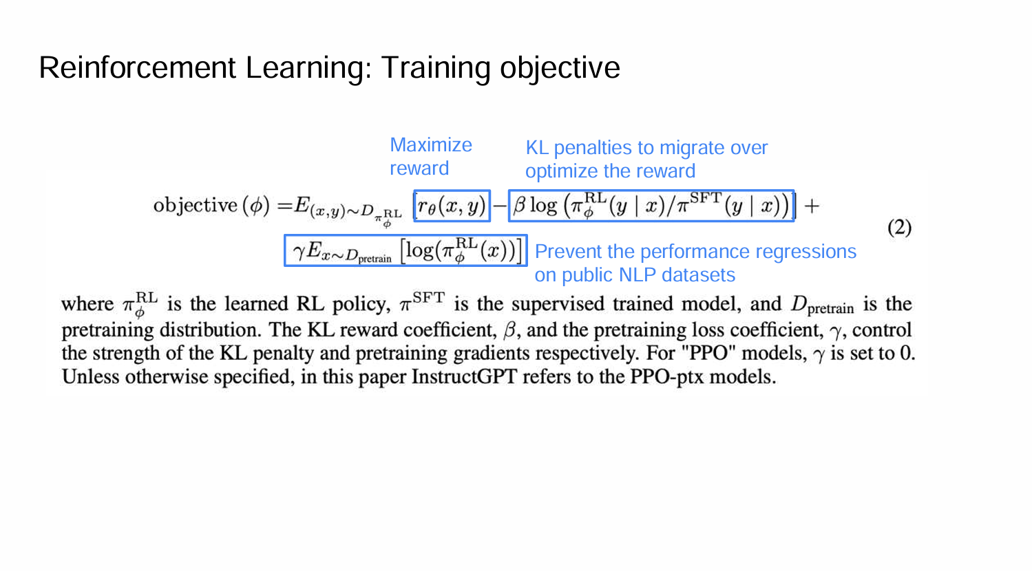
Notes:
ppo was performing a littel worse on public nlp data sets. thats why pretraining gradients were used

Slide 17
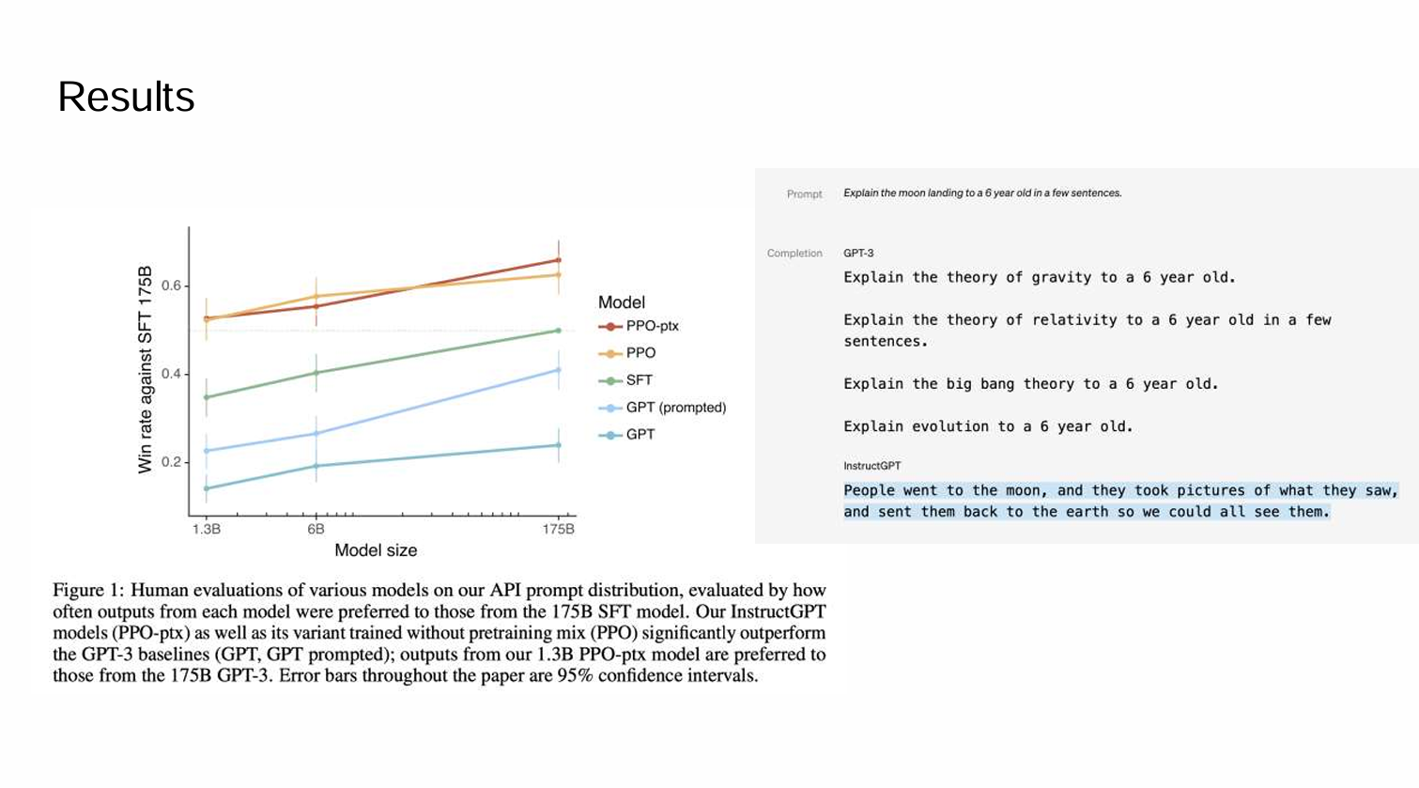
Notes:
preferecne is higher for ppo

Slide 18
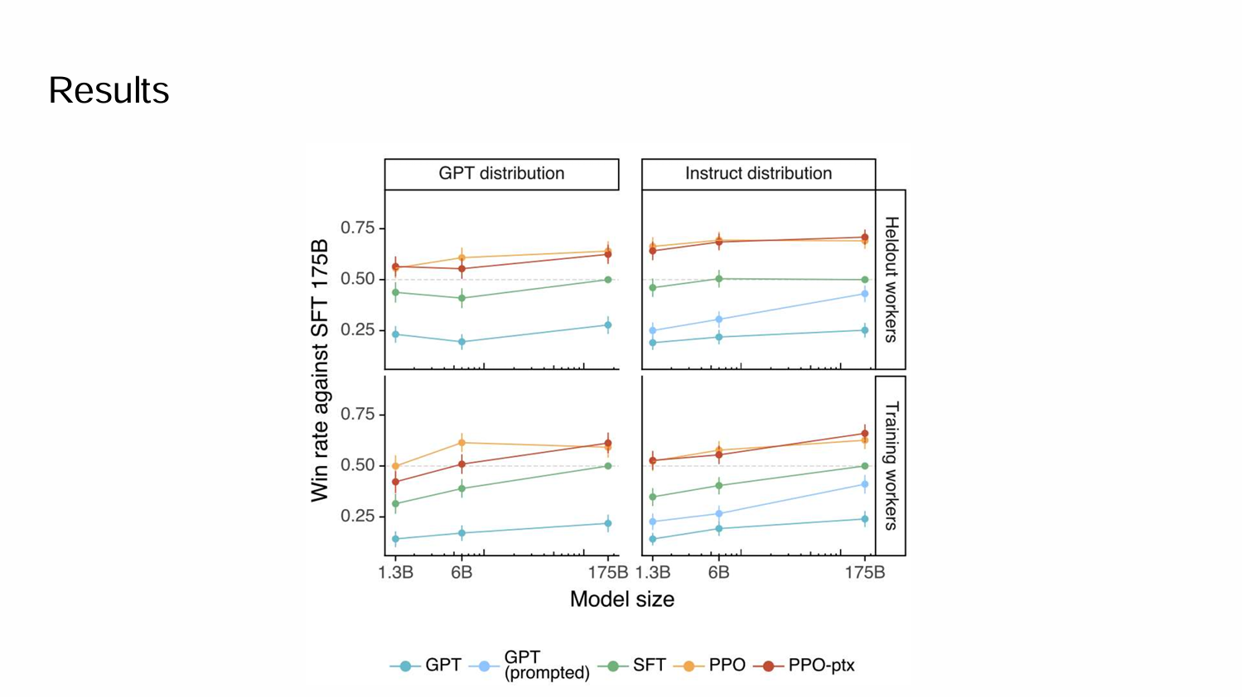

Slide 19
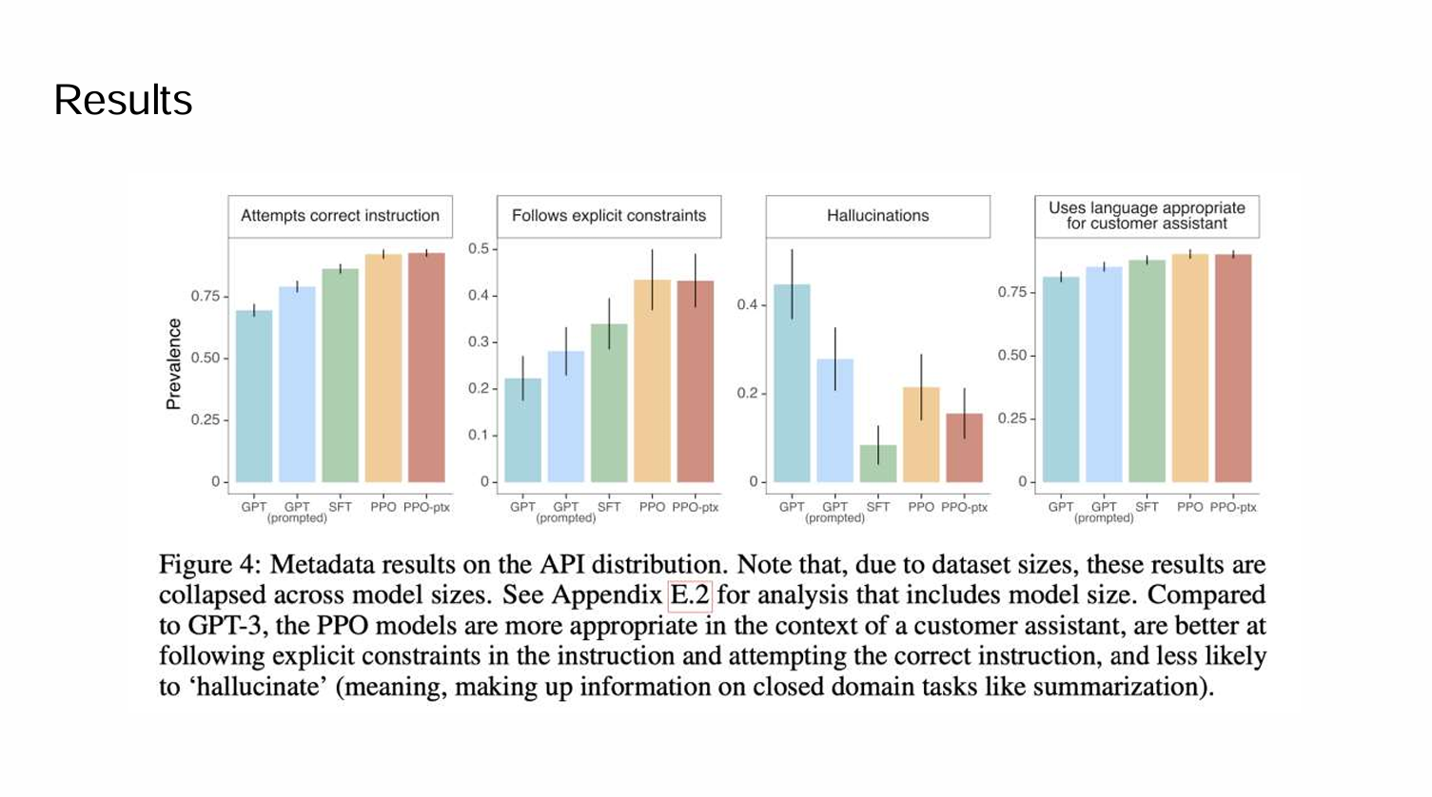
Notes:
in the context of a customer assistant

Slide 20
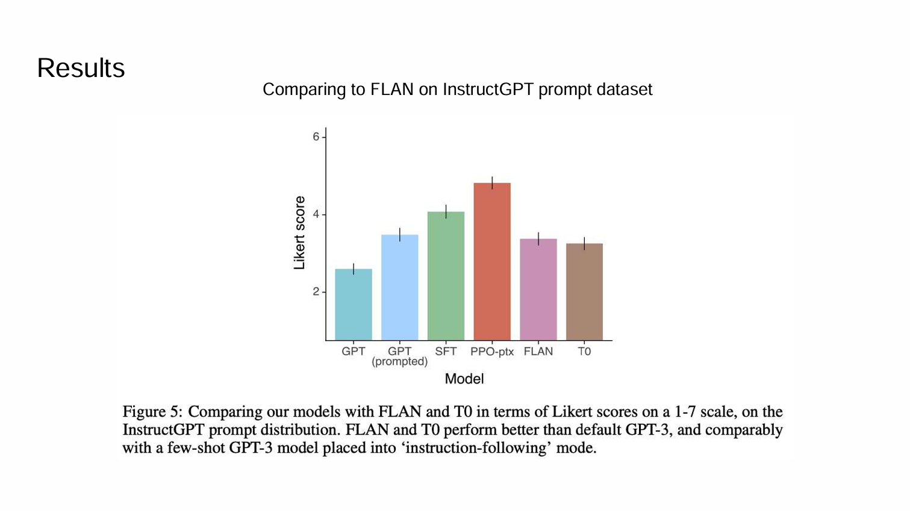
Notes:
likert score- 1 strongly disagree 2 disagree 3 neutral 4 agree 5 strongly agree
flan and t0 were already existing at the time instruction following models. using t5 model as the basae model(text to text transfer transformer) t0 zero shot geenration

Slide 21
Qualitative results
They notice that it often produces an output in English even when the
instruction is in another language.
In comparison, they find that GPT-3 can perform these tasks but
requires more careful prompting, and rarely follows instructions in
these domains.

Slide 22
Discussion
Implications for alignment research
1 Increasing investments in alignment of existing language models is more cost-effective than training larger models
2 More research is needed to study how well this generalization scales with increased capabilities
The goal of this paper is to demonstrate that this alignment technique
can align to an specific human reference group for a specific
application.

Slide 23
Future work
They need to design an alignment process that is transparent
They need to prevent model to generate the contents that will
harm the real world
Filtering the pretraining mix data for toxic content
The model can’t represent full spectrum of people who will use

Slide 24
Thank You!
Notes:
it can still make factual errors or reinforce biases, because it’s built on the same base model as GPT-3, which was trained on large internet datasets. InstructGPT performs better on instruction-based prompts like “Summarize this article” or “Write a poem about space,” where following user intent is important.
GPT-3 is trained to predict the next word in a sentence from internet text, while InstructGPT is fine-tuned to follow human instructions using feedback and reinforcement learning.

